Slide 1
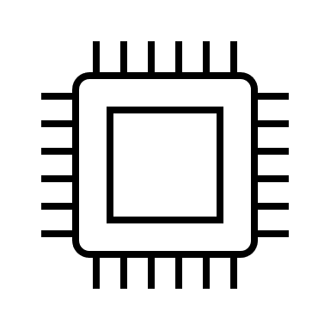
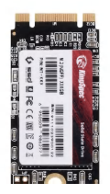
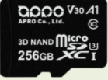
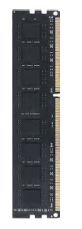
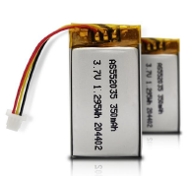
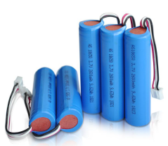
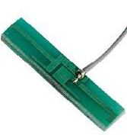
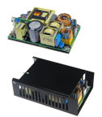
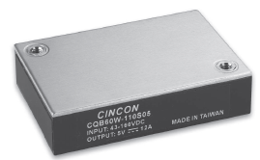
Y-not Products Diagram
MCU
SoC/SOM
Connectivity Module (WIFI/BT)
Cellular Module (IoT/LTE-M/NB-IoT)
Storage (SD/SSD/DIMM )
Video Converter IC
FLASH
Li-Ion & Li-Polymer Battery
RF Antenna
GNSS Module
Display AMOLED/LCD
DDR/eMMC
CAMERA Module
Power MOSFET
/ SiC SBD
AC/DC & DC/DC Power Block

